Slide 1
Education Benefits
Benefits in this lesson cannot be determined until the rest of the return has been completed
Pub 4491 –Lessons 9, 18 and 24 Pub 4012 – Tab J
Pub 970
Notes:
Slide 10: spelled out “Education” instead of abbreviating it.
Slide 15: copied footnote that showed on next slide
Slide 25: added the word “nonrefundable” for students who could be claimed as a dependent but aren’t
Slide 30: deleted duplicate bullet about 3rd party payments
Slide 38: grammar correction and changed phase out amount to $110,000 (from $110)
Slide 57: added “for Education Expenses” to the title slide
Slide 62: erroneously said TaxSlayer would include expenses on Form 2106; changed to Sch A—miscellaneous expenses subject to 2% floor
Slide 98: added “unrestricted” to grants that student can choose to pay tax on
Slide 100: added “unrestricted” to grants for simple case decision
Slide 123: changed URL for Bogart’s tools to cotaxaide.org/tools (more commonly used)

Slide 2

Many Different Benefits
Congress has passed many different laws giving tax benefits for education.
Summarized in 4012, Pages J-2 and J-3.
Sometimes different benefits use the same words but have different definitions for them.

Slide 3
Common Definitions
“Qualified educational institution”
  ALWAYS means any accredited public, nonprofit, or private post-secondary institution eligible to participate in Dept. of Education student aid program
    College or university
    Technical, trade or vocational school
  See https://fafsa.ed.gov/FAFSA/app/schoolSearch

Slide 4
Common Definitions
“Candidate for a degree”
  ALWAYS includes anyone working toward a degree, certificate or recognized credential (e.g. cosmetology license, commercial drivers license)
  Sometimes includes primary or secondary school student

Slide 5
Common Definitions
“Qualifying Expenses”
  ALWAYS includes tuition and fees that must be paid to the school as a condition of enrollment
  Sometimes includes other expenses (See J-2)
Notes:
Specifics will be discussed later

Slide 6

Non-Qualifying Expenses
ALWAYS exclude insurance, medical expenses (including student health fees), parking fees
USUALLY exclude room and board and transportation

Slide 7
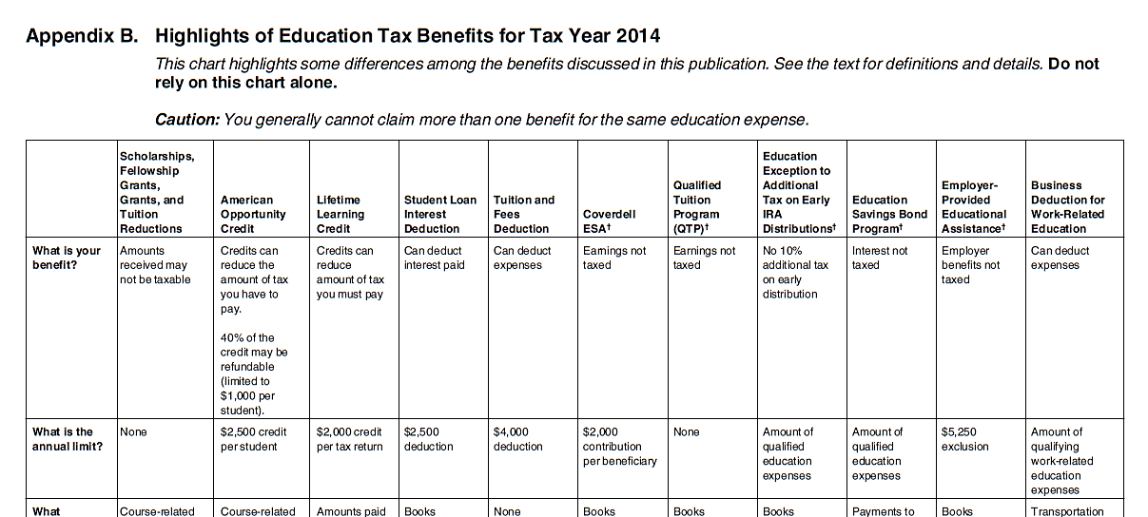
Many Different Benefits—
Pub 4012 Page J-2
Lifetime Learning Credit—this lesson
Education exception to additional tax on
early IRA distribution—Other Taxes Lesson
Education Savings Bond Program--OOS
Business deduction for work-related education—this lesson
Education Savings Accounts—this lesson
Employer-Provided Educational Assistance—this lesson
Scholarships and Grants—this lesson
Qualified Tuition Program—this lesson
Tuition and Fees Adjustment
Student Loan Interest Deduction—Adjustments Lesson
American Opportunity Credit—this lesson
2016
Notes:
Leave this page open on your desk and make notes here.

Slide 8
Many Different Benefits—
Pub 4012 Page J-2
Scholarships & Grants
American Opportunity Credit
Lifetime Learning Credit
Student Loan Interest Adjustment*
* Covered in Adjustment lesson

Slide 9
Many Different Benefits—
Pub 4012 Page J-2
Tuition & Fees Adjustment
Education Savings Account
Qualified Tuition Program
Education expenses as exception to early distribution**
** Covered in Other Taxes Lesson

Slide 10
Many Different Benefits—
Pub 4012 Page J-2
Education Savings Bond Program – Out of scope
Employer Provided Education Assistance
Business deduction Work Related Educational Expenses

Slide 11
Lesson Organization
Because there are so many different benefits:
Overview of rules for each benefit
Revisit those with exceptions to the rules
Discuss how the different benefits interact with one another and with other taxes

Slide 12
Overview of Grants and Scholarships
May be tax-free
Pub 4012 – Page J-2

Slide 13
Pub 4012 Page J-2
Find Scholarships and Grants on Pages J-2 and J-3
2015
Notes:
Leave this page open on your desk and make notes here.

Slide 14
Definitions
Grants and scholarships are different
BUT
Grants and scholarships have same tax treatment
SO
Words used interchangeably
Notes:
Scholarships: Generally an amount paid to, or for the benefit of, a student to aid in the pursuit of his or her studies.
Fellowship Grants: Generally an amount paid for the benefit of an individual to aid in the pursuit of study or research.
Need-based Grants: Generally treated as scholarships for purposes of determining their tax treatment.

Slide 15
Grants and Scholarships
Not taxable nor reportable
  IF spent on qualifying expenses
    Tuition and fees required for enrollment
    Required course-related books, supplies and equipment
  AND
  Student is a candidate for a degree* (including attendance at primary or secondary school)
*Degree always includes certificate or other credential
Notes:
Remember, candidate for a degree includes anyone working toward a degree, certificate or other credential

Slide 16
Grants and Scholarships
Taxable
  If spent on non-qualifying expenses, OR
  Student is not a candidate for a degree*
Student determines which monies are spent for which expenses. More on this later.
*Degree always includes certificate or other credential

Slide 17

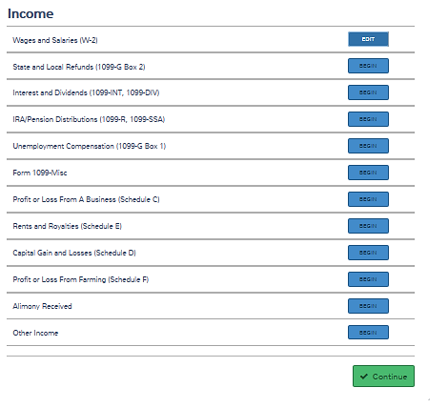
Taxable Scholarships—
In TaxSlayer
2015
Select Other Income
Student’s Tax Return

Slide 18
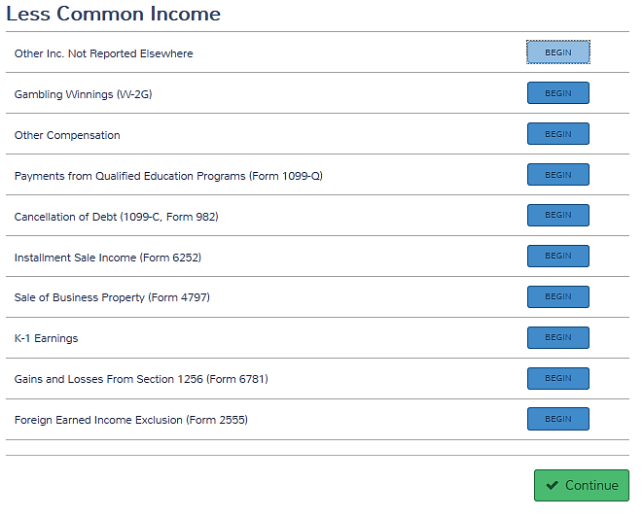
Taxable Scholarships—
In TaxSlayer
2015
Select Other Compensation
Student’s Tax Return

Slide 19
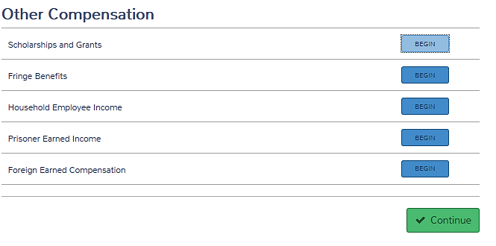
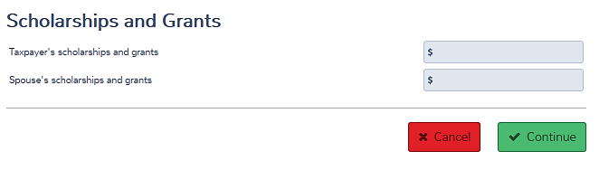
Taxable Scholarships—
In TaxSlayer
2015
Select Scholarships
and Grants
Enter taxable amount here
Notes:
Suggest they write “Other Income > Other Compensation > Scholarships and Grants” on page J-2.

Slide 20
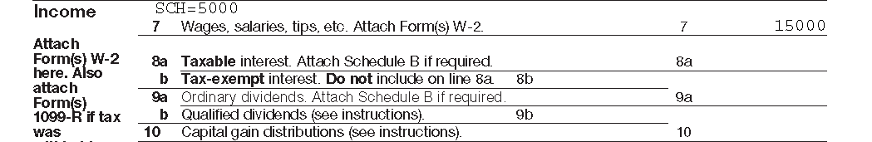
Taxable Scholarships—
Form 1040, Page 1
Taxable scholarship or grant income shows here
and is included in here
But is considered UNearned income for some calculations (e.g. EIC)

Slide 21

Grants and Scholarships Overview
Questions?
Comments?

Slide 22
Overview of Education Credits Reduce Tax,
Sometimes Refundable
Pub 4012 – Page J-2

Slide 23
Pub 4012 Page J-2
Find American Opportunity and
Lifetime Learning Credits on Page J-2 and J-3
2016
Notes:
Leave this page open on your desk and make notes here.

Slide 24
Education Credits
Two Credits
  American Opportunity—designed to cover first four years of college etc.
  Lifetime Learning—designed to cover the rest of your life
Notes:
Tuition adjustment will be discussed later

Slide 25
Rules for Both Credits
Student must be taxpayer, spouse, or dependent.
Student must not be claimed as dependent on another return.
  If student can be claimed as a dependent but isn’t, he can take the nonrefundable credits

Slide 26
Rules for Both Credits
Student must be enrolled at eligible post-secondary school.
Taxpayer cannot file “Married Filing Separate.”
Notes:
See Pub 17, Chapter 34 for Eligible Institutions, or
https://fafsa.ed.gov/FAFSA/app/schoolSearch

Slide 27
Rules for Both Credits
Taxpayer cannot treat spouse as nonresident alien.
Taxpayer’s AGI must be below limit for filing status.

Slide 28
Qualified Expenses
Tuition and certain related expenses required for enrollment or attendance
Student activity fees paid to institution as condition of enrollment or attendance
Notes:
Does NOT include student fees for personal expenses like dorm fees, health fees, or parking fees even if required for enrollment

Slide 29
Qualified Expenses
If student is dependent, expenses paid by student considered paid by taxpayer.
Costs paid by 3rd party, treated as paid by student.
Notes:
3rd party may be relative such as grandparent
For credits if grandparent pays, it is deemed paid by the student and parent taxpayers can claim)

Slide 30
Qualified Expenses
Expenses paid in 2016 for academic period beginning 2016 or first 3 months of 2017.
Notes:
3rd party may be relative such as grandparent
For credits if grandparent pays, it is deemed paid by the student and parent taxpayers can claim)

Slide 31
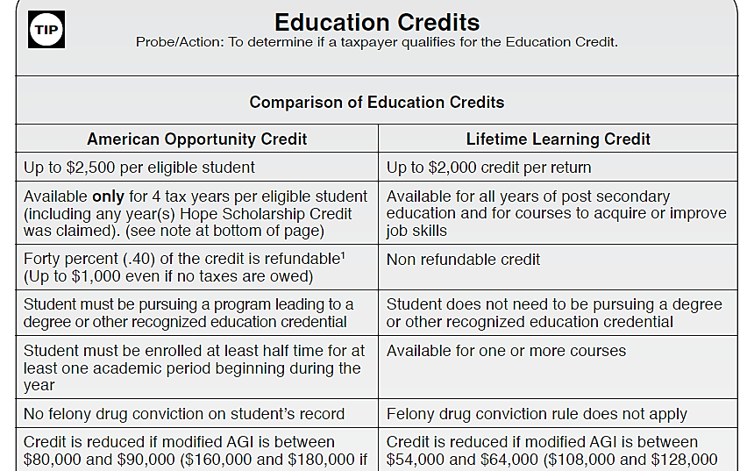
Each Credit Has Different Rules – See Pub 4012 Tab J
Turn to Page J-5
Notes:
NOTE that the refundable credit is not allowed in certain circumstances

Slide 32
American Opportunity Credit
Credit worth up to $2,500 per student
  100% of first $2,000 of expenses
  25% of second $2,000 of expenses
  Generally 40% refundable*
*Not refundable if student under age 24
and meets certain requirements (Page J-10)

Slide 33
American Opportunity Credit
Can be taken only four tax years
First four years of academic credit after high school
Student is a candidate for a degree*
*Includes certificate or other credential

Slide 34
American Opportunity Credit
Minimum of half-time workload as set by school for at least one term
No felony drug convictions
Phased out for AGI greater then $80,000 ($160,000 if MFJ)
Notes:
Course Material must be required but can be purchased anywhere.
½ normal full-time defined by institution – See 1098-T later.

Slide 35
American Opportunity Credit
Qualified expenses include course-related books, supplies and equipment (a computer if required by institution)
  Can be purchased anywhere
Notes:
Course Material must be required but can be purchased anywhere.
½ normal full-time defined by institution – See 1098-T later.

Slide 36
Lifetime Learning Credit
Credit worth up to $2,000 per RETURN
  20% of first $10,000 of expenses
  Not a refundable credit
Felony drug conviction not a disqualifier

Slide 37
Lifetime Learning Credit
No limit on number of years
No minimum amount of course workload
Not required to pursue a degree
  If not toward a degree, must be to acquire or improve job skills

Slide 38
Lifetime Learning Credit
Qualified expenses include tuition and fees only (books only if MUST be purchased from school as a condition of enrollment)
Phased out for AGI greater than $55,000 ($110,000 if MFJ)

Slide 39
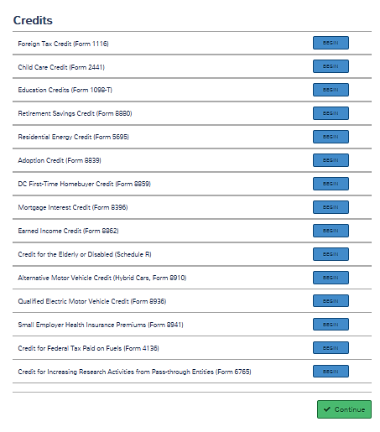
Claim the Credit—
In TaxSlayer
From Credits menu select Education Credits
Parents’ Tax Return (if student is a dependent)

Slide 40
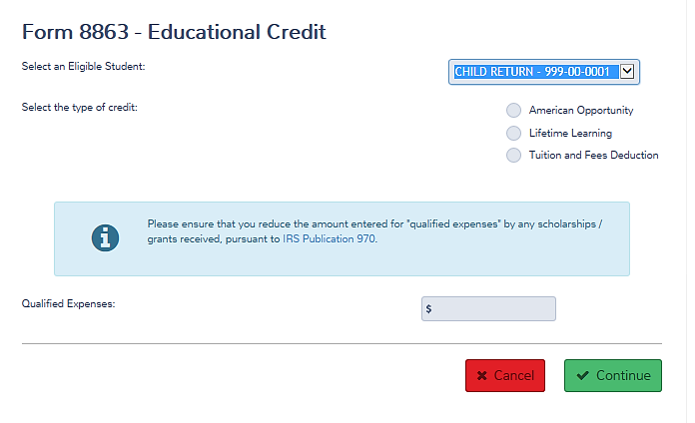
Claim the Credit—
In TaxSlayer
Select the student
and the credit or adjustment

Slide 41
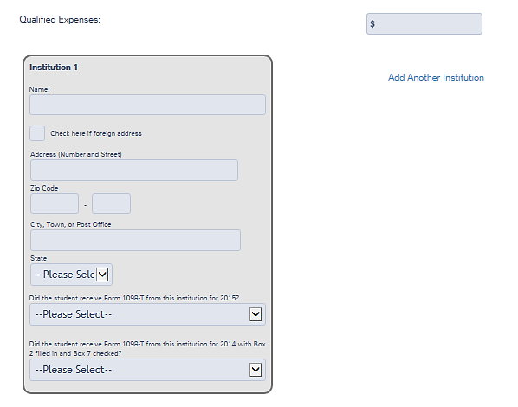
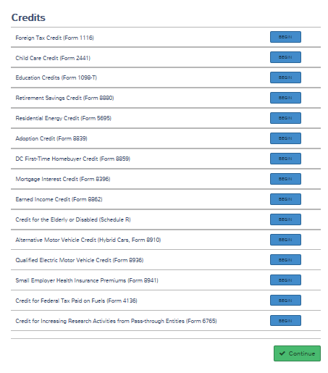
Claim the Credit—
In TaxSlayer
Claim the Credit—
In TaxSlayer
Enter qualified expenses
Enter information from Form 1098-T
Notes:
Be careful: If you select American Opportunity Credit, but TaxSlayer determines that the student does not qualify for AOC and claims LLC, the qualifying expenses will be incorrect.

Slide 42
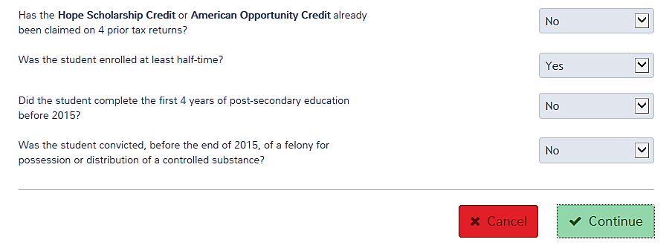
Claim the Credit—
In TaxSlayer
Claim the Credit—
In TaxSlayer
If you answer the first question “No,”
…you will be asked additional questions for the American opportunity credit.
If you wish to use LLC, answer “Yes.”
Notes:
Be careful. TaxSlayer will apply expenses to the credit it determines best. If you wish to force it to use LLC, you MUST answer the first question with “Yes.”

Slide 43
Claim the Credit
Claim the Credit—
In TaxSlayer
TaxSlayer
  Prepares Form 8863
  Carries nonrefundable Education Credits to 1040 Line 50
  Carries refundable Education Credits to 1040 Line 68

Slide 44
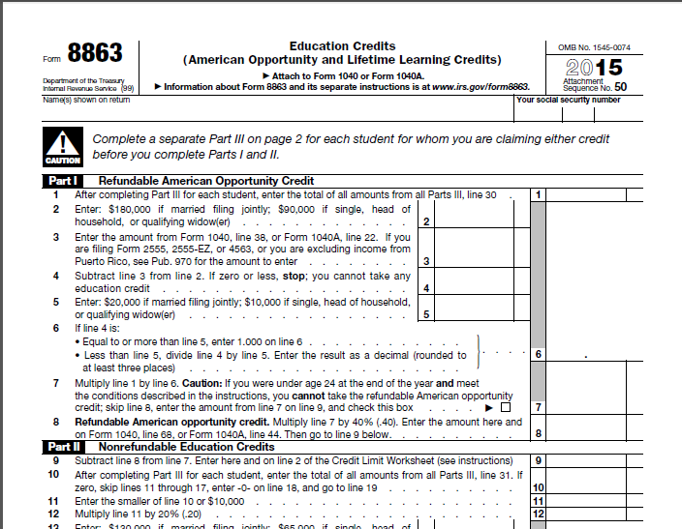
Form 8863

Slide 45
Education Credits Overview
Questions?
Comments?

Slide 46
Overview of
Tuition and Fees
Adjustment
Reduces AGI
Pub 4012 Page J-4

Slide 47
Pub 4012 Page J-2
Find Tuition and Fees Adjustment on Pages J-2 and J-3
2015
Notes:
Leave this page open on your desk and make notes here.

Slide 48
Rules for T&F Adjustment
Student must be taxpayer, spouse, or dependent.
Student must not be claimed as dependent on another return.
  If student can be claimed as a dependent but isn’t, he can NOT take adjustment
Notes:
Refer students to Resource Tool which includes education benefits

Slide 49
Rules for T&F Adjustment
Student must be enrolled at eligible post-secondary school.
Taxpayer cannot file “Married Filing Separate.”
Taxpayer cannot treat spouse as nonresident alien.
Notes:
See Pub 17, Chapter 34 for Eligible Institutions

Slide 50
Rules for T&F Adjustment
Taxpayer’s AGI must be below limit for filing status.
  MFJ: $160,000
  All others: $ 80,000
Notes:
See Pub 17, Chapter 34 for Eligible Institutions

Slide 51
Qualified Expenses
Includes tuition and fees that must be paid to the school as a condition of enrollment
Includes books and supplies ONLY if they MUST be purchased from the school as a condition of enrollment

Slide 52
Qualified Expenses
If student is dependent, expenses paid by student NOT considered paid by taxpayer.
Costs paid by 3rd party, treated as paid by student.
Notes:
May want to note this difference between credits and T&F on page J-3

Slide 53
Claim the T&F Adjustment—
In TaxSlayer
From Credits menu select Education Credits
Parents’ Tax Return (if student is a dependent)

Slide 54
Claim the T&F Adjustment—
In TaxSlayer
Select the student
and the adjustment
Enter the expenses

Slide 55
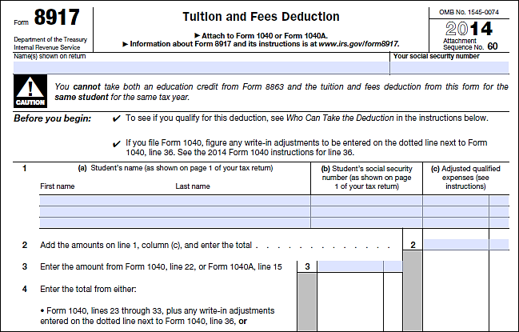

The Tax Form
15
TaxSlayer completes Form 8917.

Slide 56
Tuition and Fees Adjustment Overview
Questions?
Comments?

Slide 57
Overview of Business Deductions for Education Expenses
Schedule A—Employee Schedule C—Self-employed

Slide 58
Pub 4012 Page J-2
Find Business deduction for work-related education on pages J-2 and J-3
2015
Notes:
Leave this page open on your desk and make notes here.

Slide 59
Rules for Business Deduction
Required by your employer or the law to keep current position, OR
Maintains or improves skills needed in present work.
Cannot be part of a program of study that qualifies you for new trade or business.
Cannot be required to meet minimum standards for current position
Notes:
OK to deduct the costs of qualifying work-related education even if the education could lead to a degree.

Slide 60
Qualifying Expenses
Tuition and fees that must be paid to the school as a condition of enrollment
Course-related books, supplies and equipment
Transportation
Travel Expenses

Slide 61
Schedule A—Employee Business Expense
From Itemized Deductions menu, select Unreimbursed Employee Business Expense
Select Add/Edit Unreimbursed Employee Expenses that are not listed above

Slide 62

Schedule A—Employee Business Expense
TaxSlayer will include expenses on Schedule A—miscellaneous expenses subject to 2% floor

Slide 63
Schedule C—Self-employment Business Expense
From Profit or Loss From A Business menu, select Other Expenses

Slide 64
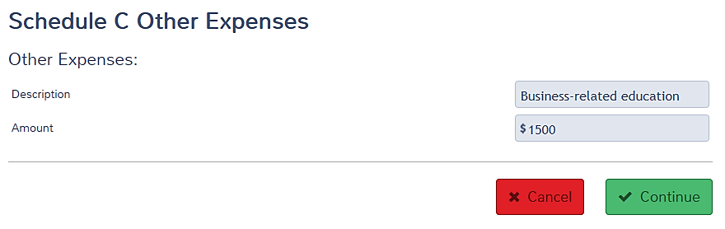
Schedule C—Self-employment Business Expense
TaxSlayer will include expenses on Schedule C Part V

Slide 65
Business Expense Overview
Questions?
Comments?

Slide 66
Other Tax-free Payments

Slide 67
Pub 4012 Page J-2
Find Education Savings Accounts and Qualified Tuition Programs on pages J-2 and J-3
2016
Notes:
Leave this page open on your desk and make notes here.

Slide 68
Education Savings Accounts
Form 1099-Q—Distributions from:
  Coverdell Education Savings Accounts
  Qualifying Tuition Programs (also called Section 529 Plans)
Not taxable nor reportable if used for qualifying expenses (See J-2)
Do not include on the return

Slide 69
Education Savings Accounts
Partially taxable if
  Distributions exceed qualified expenses
  OR
  Distributions spent on non-qualified expenses
Out of scope if taxable

Slide 70
Qualifying Expenses
Tuition and fees required for enrollment
Books, supplies and equipment required for enrollment
Expenses for special needs services
Room and board if student is at least half-time
Notes:
Pages J-2 and J-3 help to keep the differences straight

Slide 71
Qualifying Expenses
Coverdell ESAs also cover
  Transfers to QTPs
  Various expenses for
    Elementary school students
    Secondary school students
Notes:
Pages J-2 and J-3 help to keep the differences straight

Slide 72
Employer-Provided
Educational Assistance
Find Education Employer-Provided Educational Assistance on pages J-2 and J-3
2016
Notes:
Leave this page open on your desk and make notes here.

Slide 73
Employer-Provided
Educational Assistance
Employers can provide up to $5,250 of tax-free educational assistance to employees
  Should not be included on W-2
  Should not be reported on tax return
  Expenses paid with tax-free employer-provided assistance cannot be used anywhere on the tax return

Slide 74
Veterans’
Educational Assistance
Should not be included on W-2
Should not be reported on tax return
Expenses paid with VA education assistance cannot be used anywhere on the tax return

Slide 75
Other Tax-Free Payments Overview
Questions?
Comments?

Slide 76
No Double Dipping

Slide 77
No Double Dipping
Each student can claim (or be claimed for) only one of these three benefits
  American Opportunity Credit
  Lifetime Learning Credit
  Tuition and Fees Adjustment

Slide 78
No Double Dipping
Different credits or adjustment can be claimed for different students
Example:
  Taxpayer’s dependent child is full-time college student—American Opportunity
  Taxpayer takes one job-related course at local college—Lifetime Learning

Slide 79
No Double Dipping
Unused expenses can be applied to other benefits
Previous Example:
  Taxpayer’s books can be employee business expense since course was job-related

Slide 80
No Double Dipping
Same expenses cannot be used twice.
Examples:
  If expense applied toward tax-free grant, cannot be applied toward a credit
  If expense applied toward a credit, cannot be taken as a business expense
  If expense paid by tax-free VA assistance, cannot be used anywhere on return

Slide 81
No Double Dipping
In other words, qualified expenses must be reduced by amount paid with:
  Tax-free scholarships and grants
  Employer- or VA-provided educational assistance
  Any other nontaxable payments (other than gifts, bequests, or inheritances)

Slide 82
No Double Dipping
If grant or scholarship conditions allow:
  Student can choose to pay tax on all or part of the scholarship/grant, then it won’t be tax-free, and
  Student or parents can use all expenses toward education credits
Larger education credit may offset added tax

Slide 83
No Double Dipping Exception*
Regardless of how education expenses treated (credit or deduction)
Can ALSO be used to reduce early IRA distribution penalty
* Not a double dip because reducing the penalty is not taxable income nor deduction
Notes:
Students should note that Pub 970 highlights this exception and the education expenses that can be used to reduce the penalty include room and board
The exception to the premature distribution penalty applies only to IRAs.

Slide 84
Exceptions to the Rules
And Exceptions to the Exceptions

Slide 85
Qualifying Expenses
Rule: Tuition and fees that must be paid to the school as a condition of enrollment
Exception: But not required health or transportation fees
Excptn to Excptn: Health and transpor-tation fees are OK for 1) tax-free grants and 2) education savings accounts
Notes:
Pages J-2 and J-3

Slide 86
Refundable American Opportunity Credit
Rule: 40% of American Opportunity Credit is refundable
Exception: If student is not claimed as a dependent but is under age 24, credit is not refundable
Excptn to Excptn: See next two slides (Page J-10)

Slide 87
Claiming AOC – Under Age 24
None of American Opportunity Credit is refundable if
Taxpayer claiming credit is
  under age 18 -OR-
  age 18 at end of year, and their earned income was less than one-half of their own support -OR-
  a full time student over 18 and under 24 and their earned income was less than one-half of their own support
  AND ...
Notes:
These are the same criteria as for the kiddie tax

Slide 88
Claiming AOC – Under Age 24
Taxpayer has at least one living parent,
AND
Taxpayer does not file a joint return
But can still claim nonrefundable portion of the American Opportunity Credit!

Slide 89
Qualifying Educational Institution
Rule: School is any accredited public, nonprofit, or private post-secondary institution eligible to participate in Dept. of Education student aid program
Exception: Can include primary and secondary schools for 1) tax-free scholarships and 2) Coverdell ESAs
No excptn to excptn

Slide 90
Sports and Hobbies
Rule: Expenses for post-secondary education at a qualifying school are qualifying expenses
Exception: Not courses related to sports or hobbies
Excptn to excptn: OK if courses are part of a degree program

Slide 91
Business Expense Exceptions
Does not have to be at qualifying education institution
Qualifying Expenses include
  Transportation
  Travel

Slide 92
No Double Dipping
Rule: Same expenses cannot be used in two places
Exception: Expenses used to waive or reduce additional tax on early IRA distribution can also be used elsewhere

Slide 93
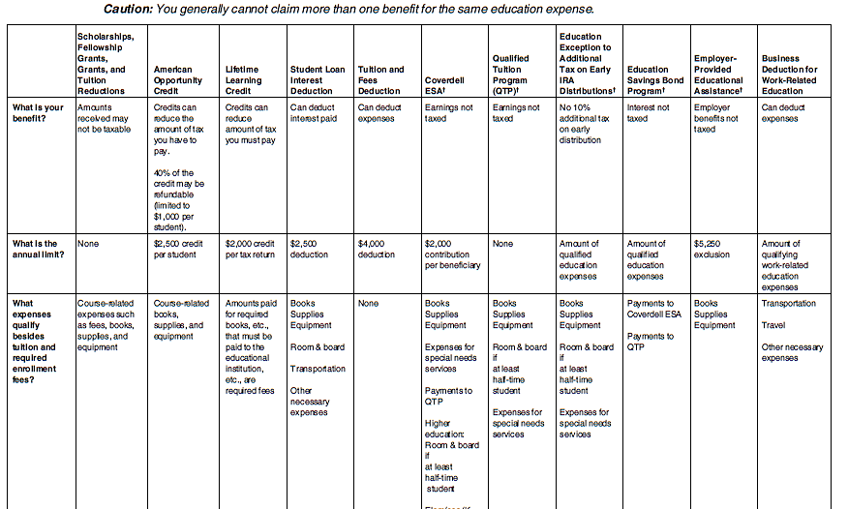
Pub 4012 Pages J-2 and J-3
It’s all here!

Slide 94
Exceptions to the Rules
Questions?
Comments?

Slide 95
Interaction Between Benefits and Other Taxes
Some Benefits Affect AGI
Some Don’t

Slide 96
Interaction of Benefits
Some Benefits Reduce Tax
  American Opportunity Credit
    100% of first $2,000
    25% of second $2,000
  Lifetime Learning Credit
    20% of first $10,000

Slide 97
Interaction of Benefits
Others reduce AGI, affecting
  Earned income credit
  Premium tax credit and shared responsibility payment
  Child and dependent care credit
  Retirement savings credit
  State tax return

Slide 98
Interaction of Benefits
Taxpayer can choose
  Where to claim expenses
  Whether to pay tax on unrestricted grants and scholarships so expenses can be used towards credits

Slide 99
Interaction of Benefits
Which is better?
How do we help him decide?
Best way is to try different scenarios in TaxSlayer and compare them

Slide 100
No Need to Compare
Use American Opportunity Credit if all the following are true:
  Qualifies for AOTC (and wants to use it)
  No unrestricted grants/scholarships
  No EITC on return
  No ACA issues

Slide 101
Comparisons
Complete federal return without education expenses.
Complete state return.
Decide which benefits student qualifies for

Slide 102
Comparisons
For each allowable benefit
  Determine amount of taxable grant/scholarship
  Enter amounts in TaxSlayer
  Record AGI, federal refund, state refund
Compare results and let taxpayer decide

Slide 103
Best Results*
Best results start with
  Tax-free scholarship,
  American Opportunity credit for $2,000,
  American Opportunity credit for $4,000,
  Lifetime Learning credit, or
  Tuition and Fees adjustment
*Unless education is related to self-employment

Slide 104
Example: Clyde
Clyde (age 27) lives with and supports his son Stevie (age 6). He works and goes to school part-time. He qualifies for AOTC.
Wages: $25,000
Pell grant: $5,400
Tuition $2,200
Books $300

Slide 105
Example: Clyde
Scenario 1: Minimize AGI by using tax-free grants to pay education expenses
Grant $5,400
Less tuition - 2,200
Less books - 300
Taxable grant $2,900

Slide 106
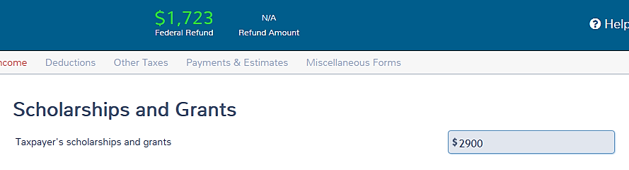
TaxSlayer Results
Taxable grant = $2,900
Refund = $1,723

Slide 107
Comparisons
STUDENT’S RETURN | $2,000 to AOC | $4,000 To AOC | Lifetime Learning | Tuition & Fees | Minimize student’s AGI | No Filing Requirement
AGI |  |  |  |  | 27,900
Federal refund |  |  |  |  | 1,723
State refund
Total refund |  |  |  |  | 1,723

Slide 108
Example: Clyde
Scenario 2: First $2,000 to AOTC
Tuition $2,200
Books + 300
Total expenses 2,500
Less AOTC expenses - 2,000
Remaining expenses 500
Unrestricted grant 5,400
Less remaining expenses - 500
Taxable grant $4,900

Slide 109
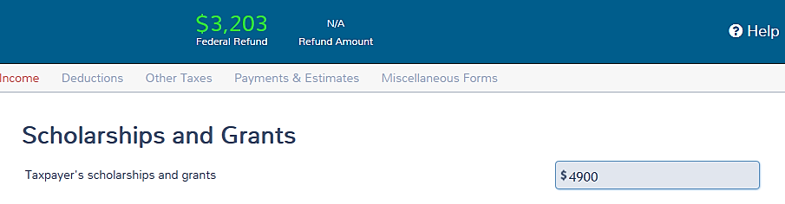
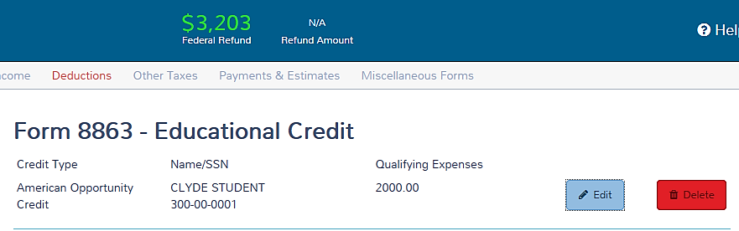
TaxSlayer Results
Taxable grant = $4,900
AOTC expense = 2,000
Refund = $3,203

Slide 110
Comparisons
STUDENT’S RETURN | $2,000 to AOC | $4,000 To AOC | Lifetime Learning | Tuition & Fees | Minimize student’s AGI | No Filing Requirement
AGI | 29,900 |  |  |  | 27,900
Federal refund | 3,203 |  |  |  | 1,723
State refund
Total refund | 3,203 |  |  |  | 1,723

Slide 111
Example: Clyde
Scenario 3: AOTC with $4,000 limit
Tuition $2,200
Books + 300
Total qualifying expense 2,500
Less AOTC expenses - 2,500
Remaining expenses 0
Unrestricted grant 5,400
Less remaining expenses 0
Taxable grant $5,400

Slide 112
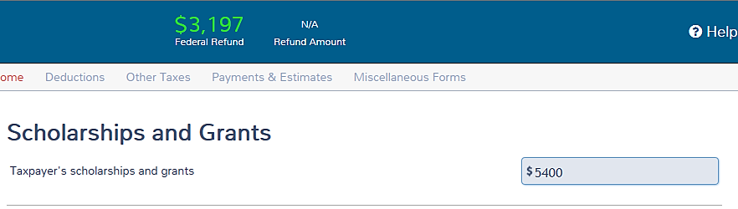
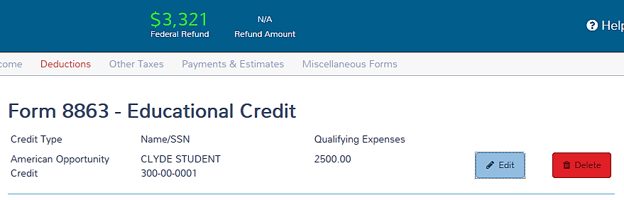
TaxSlayer Results
Taxable grant = $5,400
AOTC expense = 2,500
Refund = $3,197

Slide 113
Comparisons
STUDENT’S RETURN | $2,000 to AOC | $4,000 To AOC | Lifetime Learning | Tuition & Fees | Minimize student’s AGI | No Filing Requirement
AGI | 29,900 | 30,400 |  |  | 27,900
Federal refund | 3,203 | 3,197 |  |  | 1,723
State refund
Total refund | 3,203 | 3,197 |  |  | 1,723

Slide 114
Example: Clyde
Scenario 4: LLC
Tuition $2,200
Less LLC - 2,200
Remaining expenses 0
Unrestricted grant 5,400
Less books - 300
  Taxable grant $5,100

Slide 115
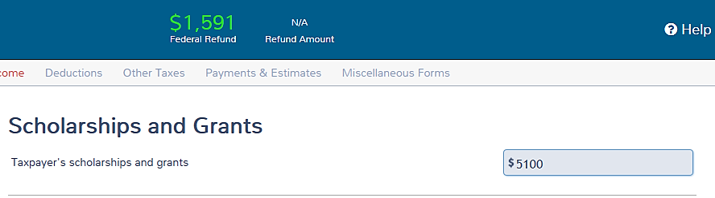
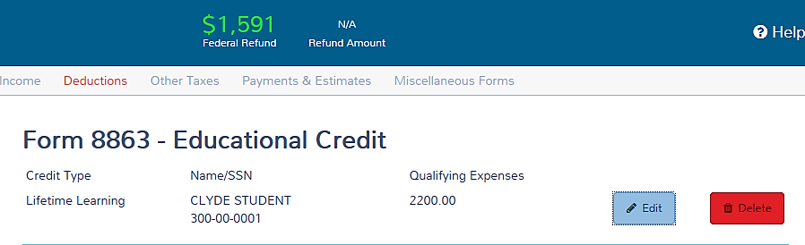
TaxSlayer Results
Taxable grant = $5,100
LLC expenses = 2,200
Refund = $1,591

Slide 116
Comparisons
STUDENT’S RETURN | $2,000 to AOC | $4,000 To AOC | Lifetime Learning | Tuition & Fees | Minimize student’s AGI | No Filing Requirement
AGI | 29,900 | 30,400 | 30,400 |  | 27,900
Federal refund | 3,203 | 3,197 | 1,591 |  | 1,723
State refund
Total refund | 3,203 | 3,197 | 1,591 |  | 1,723
Why check LLC if taxpayer qualifies for AOTC?
If there is taxable income, the qualifying expenses are high (over $7,500), and refundable portion of AOTC is not available, LLC may be better.
Not this time.

Slide 117
Example: Clyde
Scenario 5: T&F Adjustment
Tuition $2,200
Less T&F - 2,200
Remaining expenses 0
Unrestricted grant 5,400
Less books - 300
Taxable grant $5,100

Slide 118
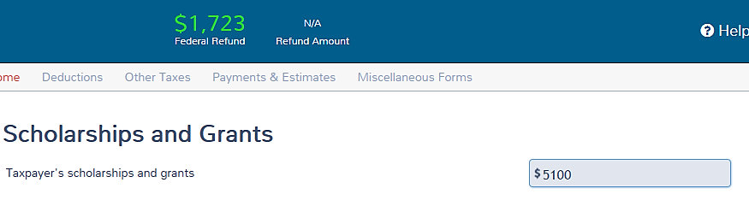
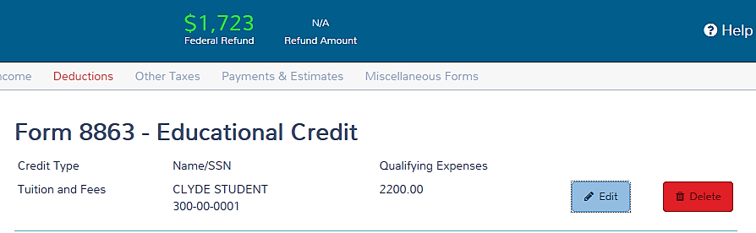
TaxSlayer Results
Taxable grant = $5,100
T&F = 2,200
Refund = $1,723

Slide 119
Comparisons
STUDENT’S RETURN | $2,000 to AOC | $4,000 To AOC | Lifetime Learning | Tuition & Fees | Minimize student’s AGI | No Filing Requirement
AGI | 29,900 | 30,400 | 30,400 | 27,900 | 27,900
Federal refund | 3,203 | 3,197 | 1,591 | 1,723 | 1,723
State refund
Total refund | 3,203 | 3,197 | 1,591 | 1,723 | 1,723
Best result is frequently surprising

Slide 120
Comparisons
STUDENT’S RETURN | $2,000 to AOC | $4,000 To AOC | Lifetime Learning | Tuition & Fees | Minimize student’s AGI | No Filing Requirement
AGI | 29,900 | 30,400 | 30,400 | 27,900 | 27,900
Federal refund | 3,203 | 3,197 | 1,591 | 1,723 | 1,723
State refund
Total refund | 3,203 | 3,197 | 1,591 | 1,723 | 1,723
When to eliminate filing requirement?
  Filing requirement created by choosing to pay tax on grants or scholarships

Slide 121
Why try to eliminate filing requirement?
For non-dependent students who meet criteria on J-10 (under age 24)
  Avoids “kiddie tax,”—occurs if taxable scholarships + unearned income greater than $2,100, and makes return OOS
For dependents
  Avoids “kiddie tax”
  Avoids adding student’s MAGI to parents’ MAGI for ACA issues

Slide 122
Comparison Tools
The “Education Calculator,” a spreadsheet from OneSupport will calculate the amount of taxable scholarship and credit expense for the most common situations.

Slide 123
Comparison Tools
Jeff Bogart’s optimizer at http://cotaxaide.org/tools will calculate precisely the most beneficial amounts of taxable scholarship and expenses to apply to the credit.

Slide 124
Education Quiz #1
Jim and May Brown, $48,000 AGI, two children
  Rose, sophomore, in college full-time
  John, 4th year full-time college senior
Both children claimed as dependents

Slide 125
Education Quiz #1
Browns made tuition payments of $6,000 in August for 2016 classes and $6,000 in December for 2017
For which education credits do they qualify?
American Opportunity Credit for both children

Slide 126
Education Quiz #1 – Part 2
Can the Browns include the payments they made in December for 2016?
Yes

Slide 127
Education Quiz #2
If Rose had paid for her own tuition, how would the answer differ?
NOT AT ALL, unless Rose not claimed as a dependent

Slide 128
Education Quiz #3
If Jim and May had not claimed Rose as a dependent (even though entitled to the exemption), who is entitled to the credit?
  ROSE is entitled to the nonrefundable credit, but not any refundable credit

Slide 129
Education Benefits
Questions?
Comments?

Slide 130
Preparing the Return

Slide 131
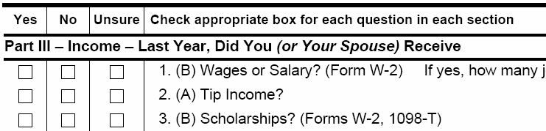

Interview Form
Point of Awareness

Slide 132
Review Tuition Statement—
Form 1098-T
Provided by college/institution
Shows
  amount paid or amount billed,
  scholarships or grants, and
  student status
If adjustments in box 4 or box 6, credit is out of scope
Notes:
Amounts paid and billed are frequently incorrect. Have student get statement of account from school—generally available on-line.

Slide 133
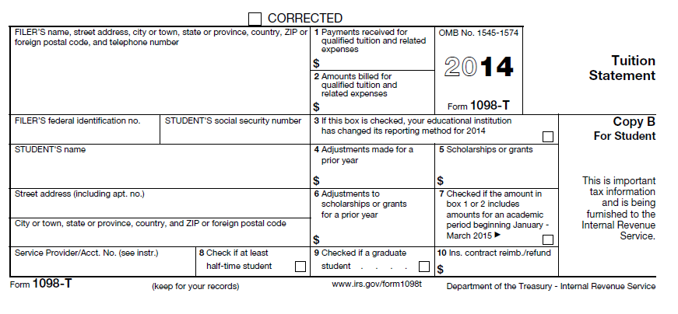
Review Tuition Statement—
Form 1098-T
Grants and Scholarships*
Total Paid: 1
16
or Amounts billed: 2
Out of Scope
Status Indicators: Boxes 8 and 9
*Adjust if any portion taxable
Notes:
But see Managing Scholarships and Education Benefits tool later for ways to reduce net tax liability

Slide 134
Review Tuition Statement—
Form 1098-T
Amounts MUST be verified with taxpayer
  Best source is the student’s statement of account with the school
  Usually available on line

Slide 135
Recovery of Prior Year’s Expenses
Expenses were claimed for either credit
  May need to recapture part of all of credits received – out of scope
Expenses were claimed as adjustment or deduction
  May need to include recovery in income if tax benefit was received in prior year

Slide 136
Review of Education Benefits
Complete federal and state returns prior to considering education expenses
Education Credits
  American Opportunity—for 1st 4 years
  Lifetime Learning—for rest of your life
Tuition and Fees Adjustment
  Reduces AGI
Student can choose to pay tax on unrestricted grants

Slide 137
Review of Education Benefits
Other ways to use education expenses
  Tax-free scholarship or grants
  Tax-free distribution from Education Savings Accounts
  Tax-free VA or employer education assistance
  Business Expense

Slide 138
Review of Education Benefits
Test different scenarios in TaxSlayer
Let the taxpayer decide
  Where to claim expenses
  Whether to pay tax on scholarships
Taxable scholarship goes on student’s return
Credit or adjustment goes on parents’

Slide 139
References—USE Tab J
Pub 970
Pub 4012 Tab J
Form 1040 Lines 7, 34, 50, 68
Sch A and Sch C
Pub 4491 Part 5 –Lesson 24 (NTTC Supplement)

Slide 140
Pub 4012 Pages J-2 and J-3
It’s all here!

Slide 141
Education Benefits
Questions?
Comments?

